Slide 1


WEBSCRPING to PyMySQL
Chandana T M
DA/DS batch 28

Slide 2


Introduction
Project Overview
This project involves scraping data from a website and storing the extracted information in a MySQL database using PyMySQL. The goal is to automate the data extraction process and make the data accessible for analysis and reporting.

Slide 3
Objectives
Extract specific data from a website.
Store the scraped data in a MySQL database.
Insert the data frame into a MySQL table.
Filter the data for specific cryptocurrencies
And perform data visualisation for that data.

Slide 4
Webscraping
Web scraping, also known as web harvesting or web data extraction, is the process of automatically extracting data from websites. It involves using software tools or scripts to collect and parse information from web pages.
Definition:
Web scraping is the technique of extracting structured data from websites by parsing the HTML content of web pages
Purpose:
To gather data for analysis, research, or integration into other applications. This can include price comparisons, market research, sentiment analysis, and more.

Slide 5
Common Tools and Libraries:
Python Libraries:
requests: For sending HTTP requests to access web pages.
BeautifulSoup: For parsing HTML and XML documents.
lxml: Another library for parsing HTML and XML.
Scrapy: A powerful and flexible framework for large-scale web scraping.
Browser Automation Tools:
Selenium: For automating interactions with web pages, often used when dealing with
dynamic content that requires user interaction.

Slide 6
Use Cases:
Data Aggregation: Collecting data from multiple sources into a single database.
Market Research: Gathering product prices, reviews, and trends.
Content Monitoring: Tracking changes or updates on websites.
Lead Generation: Extracting contact information or other details for business purposes.
Legal and Ethical Considerations:
Robots.txt: Websites often have a robots.txt file that specifies which parts of the site can be accessed by
web crawlers and scrapers.
Terms of Service: Always check a website's terms of service to ensure compliance with its rules
regarding scraping.
Rate Limiting: Avoid overwhelming a website with too many requests in a short period, which could lead
to IP blocking or other issues

Slide 7
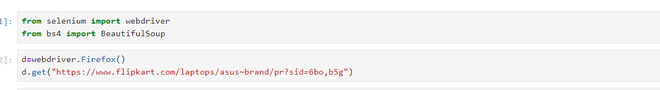
Process:
Sending a Request: A script sends an HTTP request to a website to retrieve the page content.

Slide 8
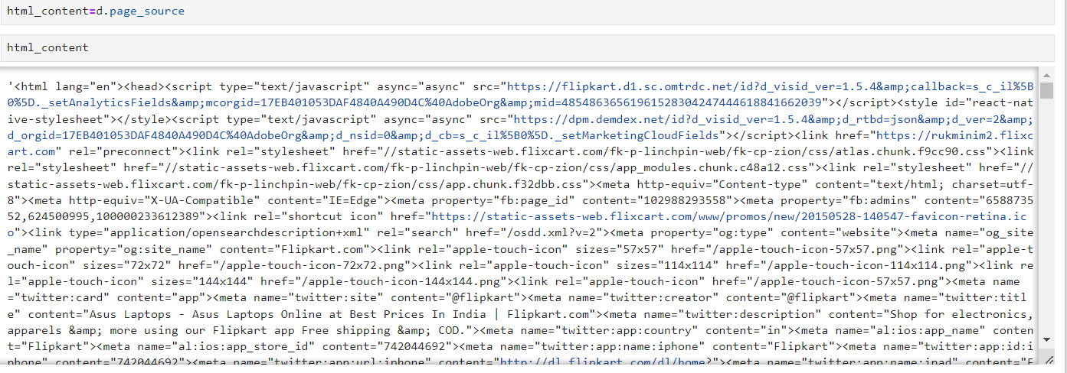

Slide 9
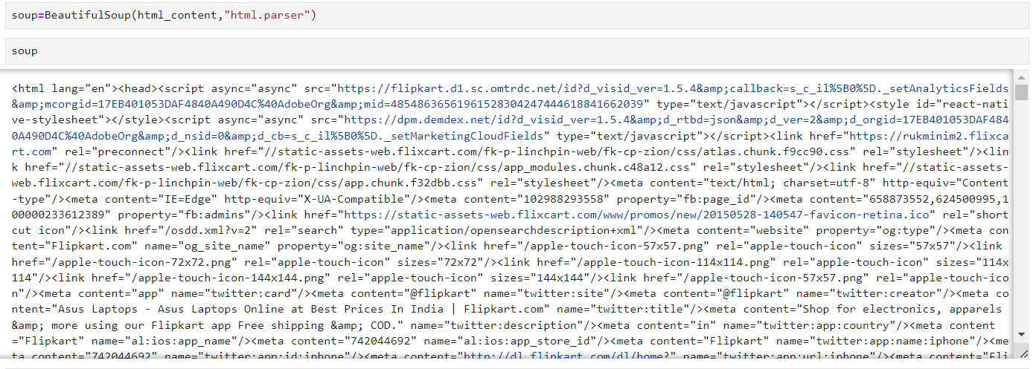
Parsing the Content:
The HTML content of the page is parsed to find the relevant data. This often involves using libraries like BeautifulSoup or tools like Scrapy.

Slide 10
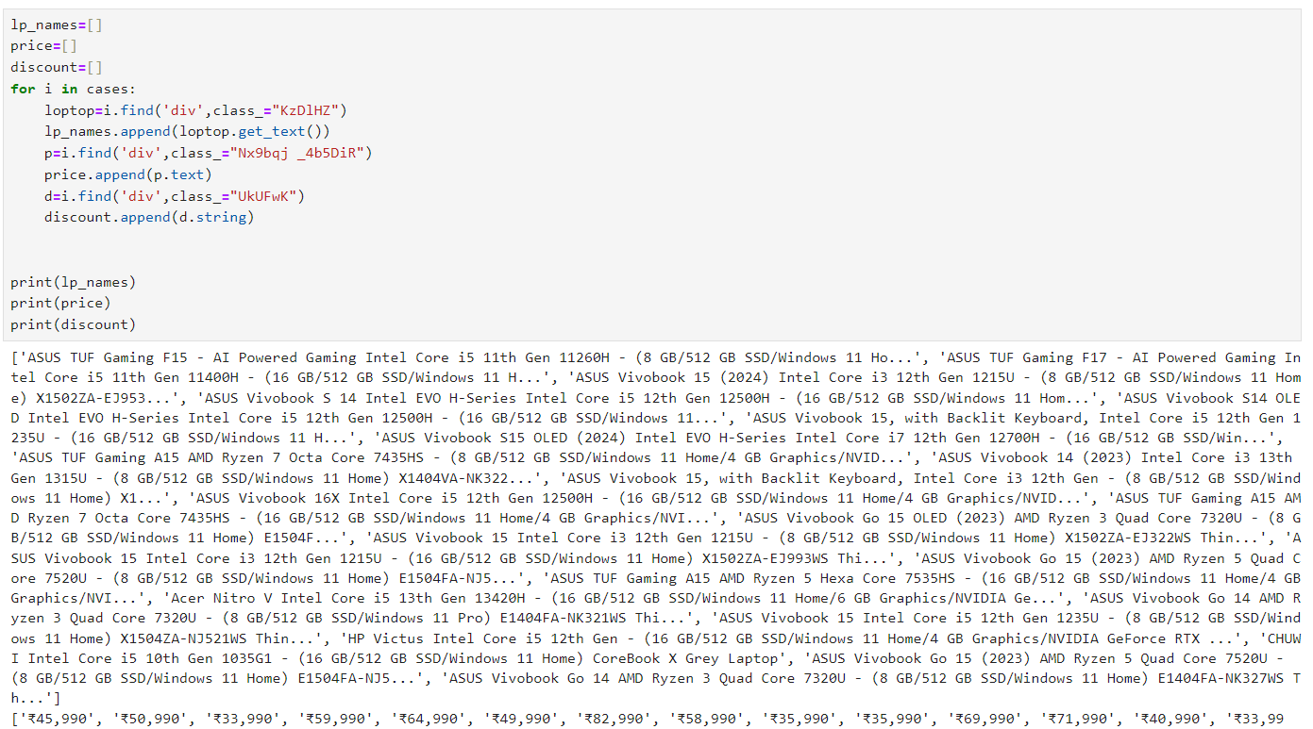
Extracting Data:
The desired data is extracted based on its location in the HTML structure.

Slide 11
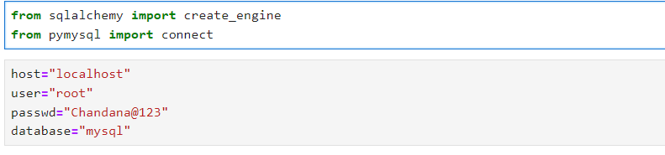
Introduction to PyMySQL
Definition: PyMySQL is a pure-Python MySQL client library.
Use: To interact with MySQL databases from Python applications.
Setting Up PyMySQL
Installation:
Connecting to MySQL:

Slide 12
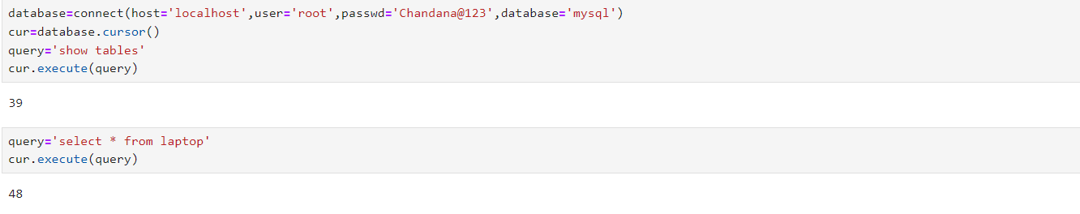
Storing Data in to MySQL:
The extracted data is then stored in a structured format such as a CSV file, database, or JSON.

Slide 13
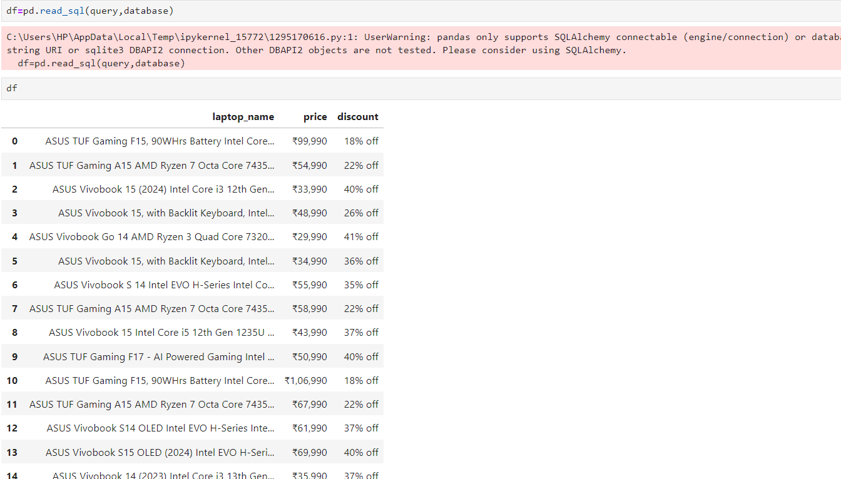

Slide 14
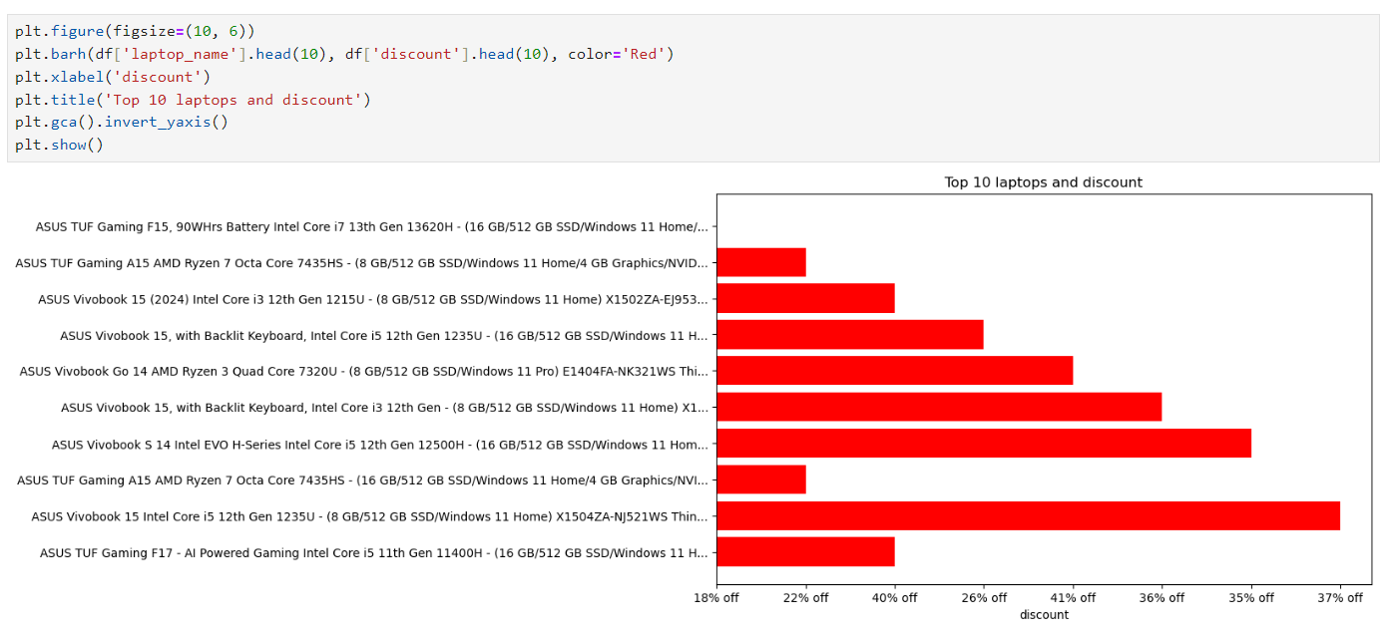
Data Visualization
Data visualization is the graphical representation of information and data. By using visual elements like charts, graphs, and maps, data visualization tools provide an accessible way to see and understand trends, outliers, and patterns in data.

Slide 15
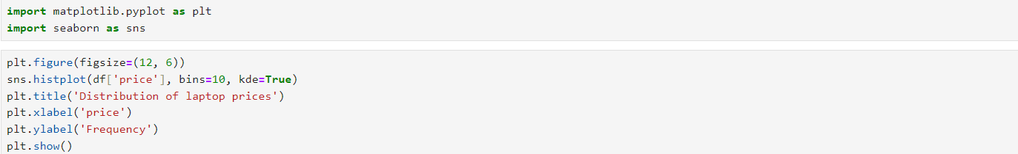
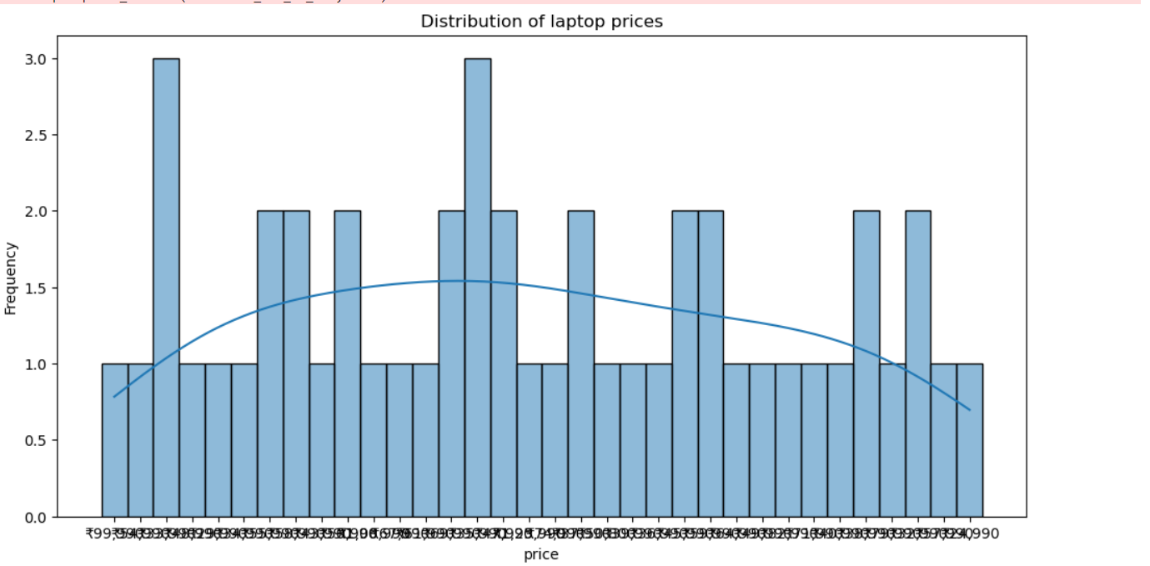

Slide 16
